Slide 1
Project 1:
Restaurant Success Analysis
Team Members:
Jeff Brown, Eugenio Gallastegui, Alan Garbarino, Hao Lu

Slide 3
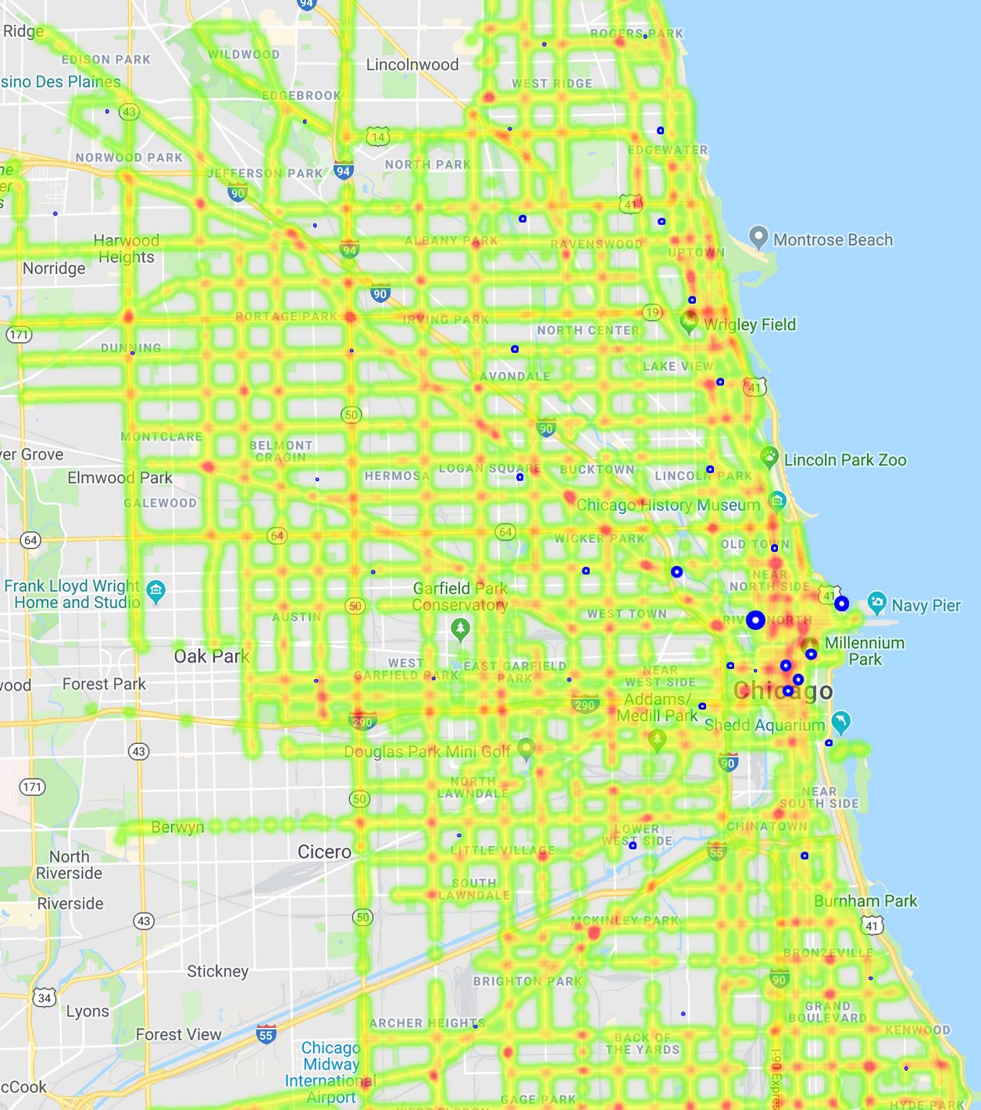
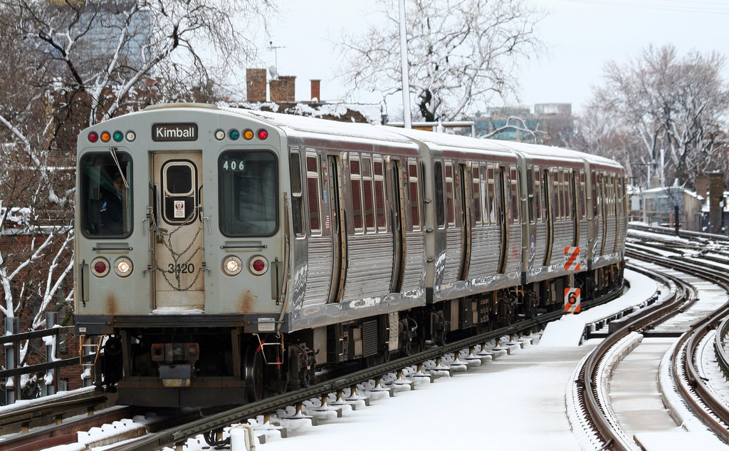
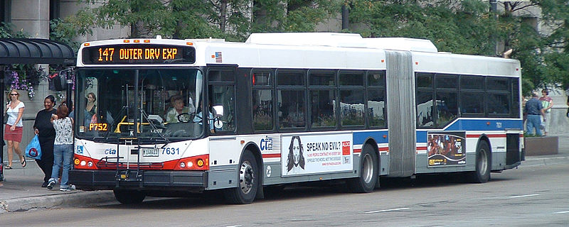
How is transportation access via CTA stops related to evaluation of restaurants in Chicago?
By Jeff Brown

Slide 4

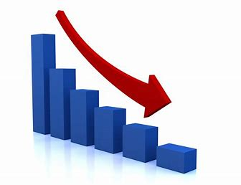
CTA Stops Make a Difference… Sometimes!
No indication that Average Yelp Restaurant Ratings are correlated with the # of CTA Stops in the area, but...
# of Yelp Restaurant Reviews and Average Price are lower in areas that have a larger number of CTA Stops!

Slide 5
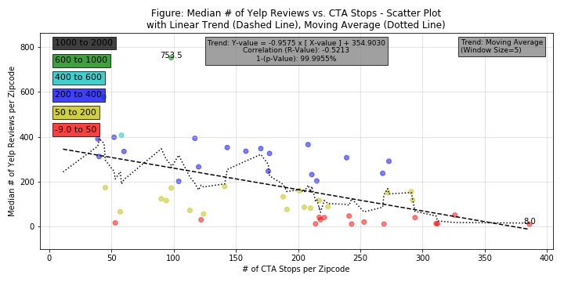
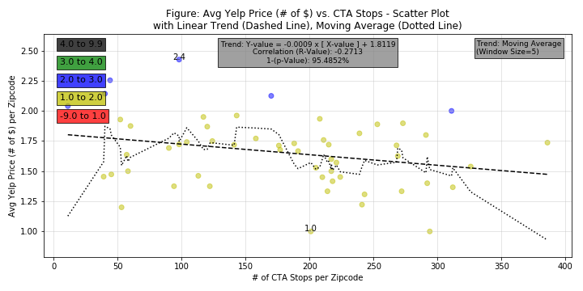
Median # of Yelp Reviews and Average Yelp Price ($, $$, $$$, $$$$)
Noteworthy correlation between # of CTA Stops and Average number of Yelp Restaurant Ratings… … some common underlying factor?*
More slight with Average Yelp Restaurant Price…
*Opportunity for Future Analysis

Slide 6
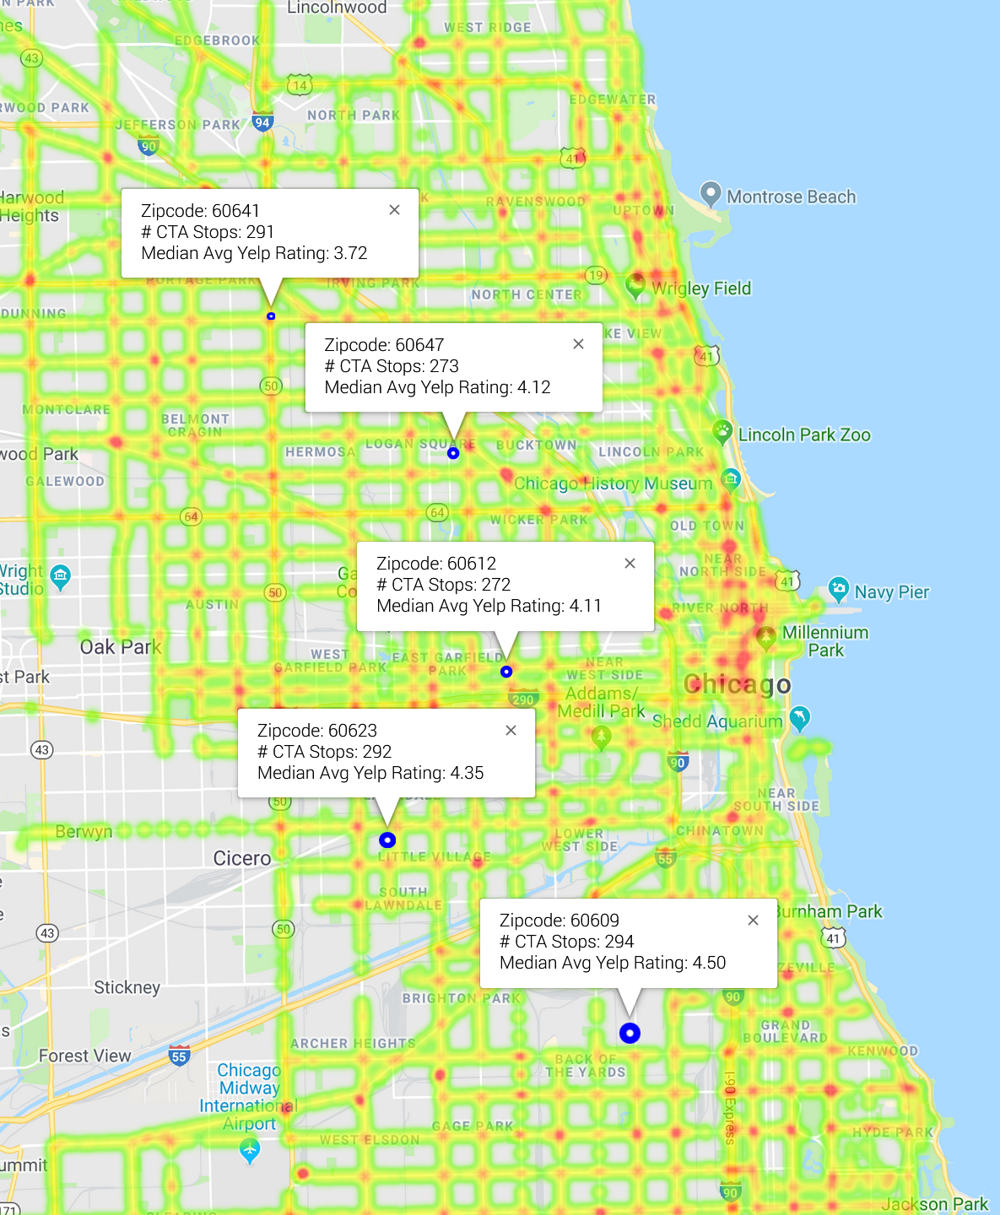
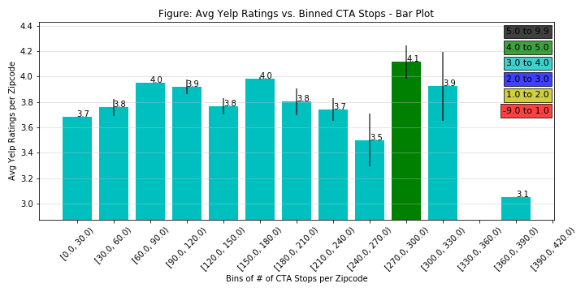
Another Look at Yelp Ratings...
Not much trend vs. # of CTA Stops, but a peak in Yelp Ratings in areas that have 270 to 300 CTA Stops…
… something unique in the demographics of these areas?*
*Opportunity for Future Analysis

Slide 7
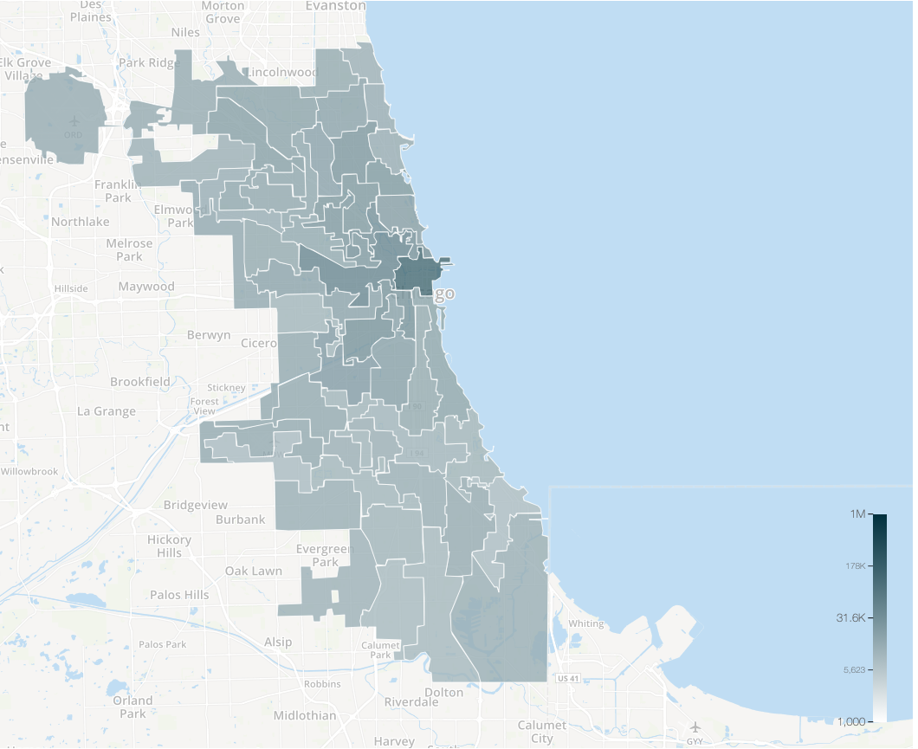
Is the distribution of income related to the distribution of restaurant licenses in Chicago?
By Eugenio Gallastegui

Slide 8
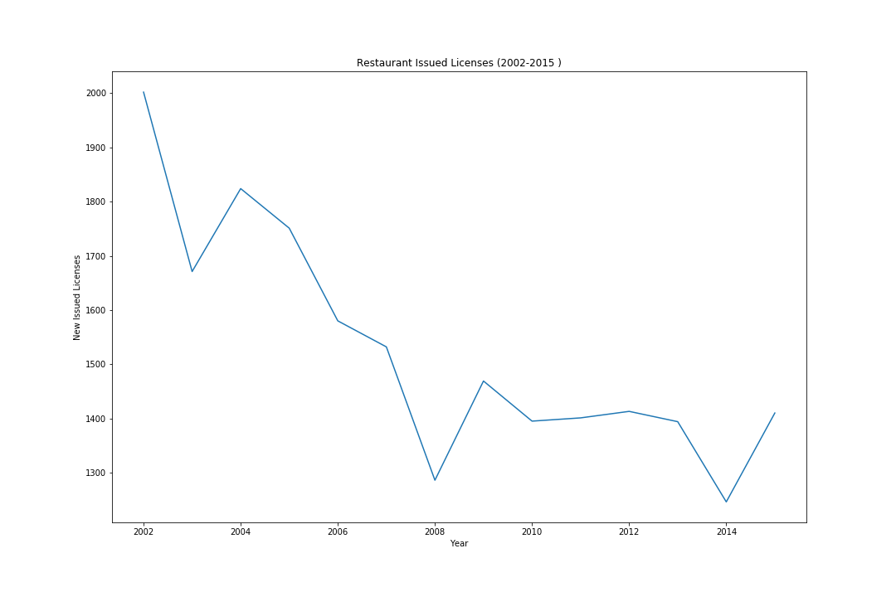
A market in decline

Slide 9
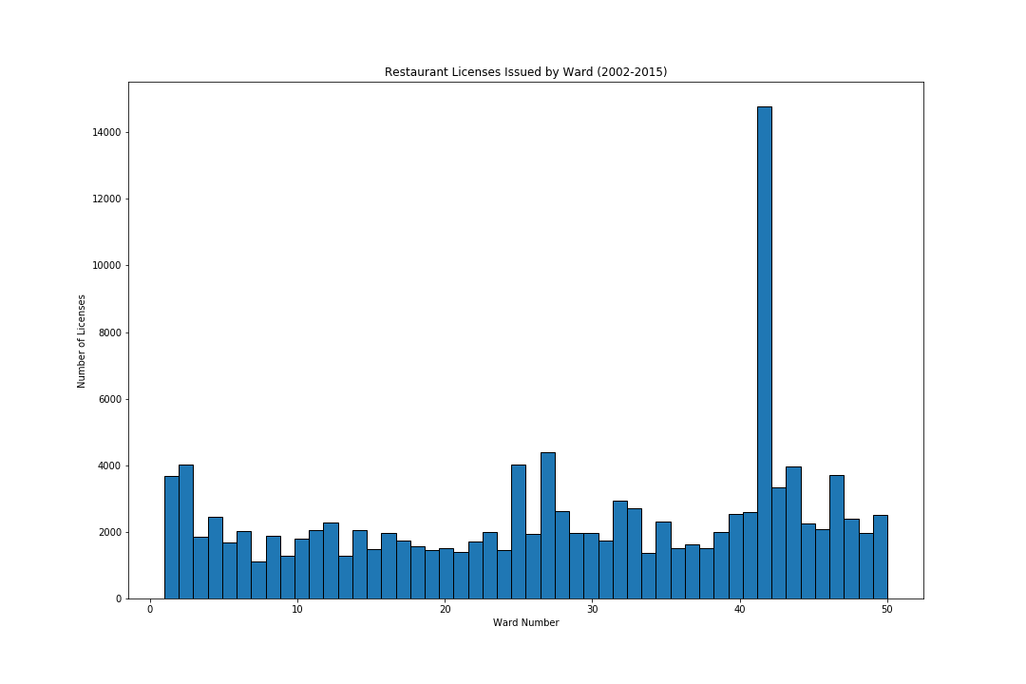
Distribution of Licenses in Chicago
The 42nd Ward has Has an unparalleled Concentration of Licenses

Slide 10
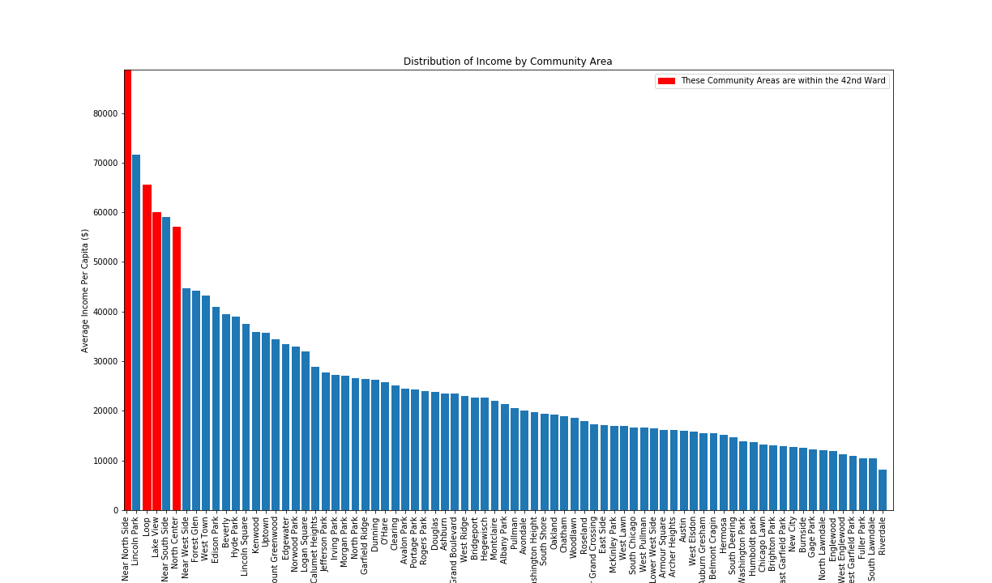
Distribution of Income by Neighborhood
Those Neighborhoods that belong to the 42nd Ward are among the richest!

Slide 11
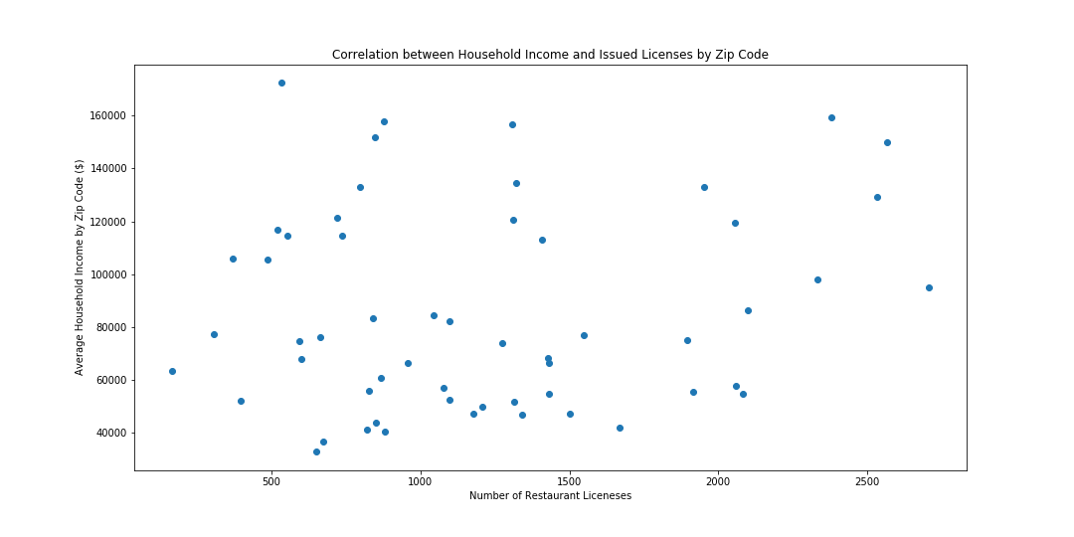
So, is there a correlation?
No. Despite the relationship between the distributions in the 42nd Ward, it seems to be the exception, not the rule…
p=0.1

